Slide 1
Object Detection and Orientation (ODO) using Yolo v3 tiny
Author: Alex Strebeck

Slide 2
Objective
The objective of this project is to train and refactor the Yolo computer vision model to detect a unique/ specific object.
Once the object is detected the algorithm will use properties of the detected object to calculate its orientation(i.e. in-plane rotation, scale, etc.)

Slide 3
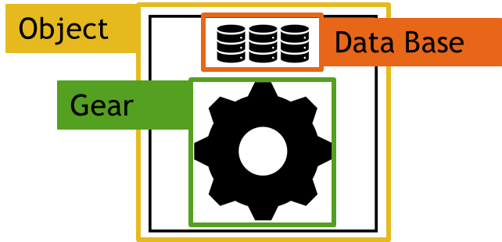
Methods
In order to begin the project a AI neural network had to be trained on a new data class that the user can create such that it is reproducible and deterministic. An example of the training classes used are shown below.

Slide 4
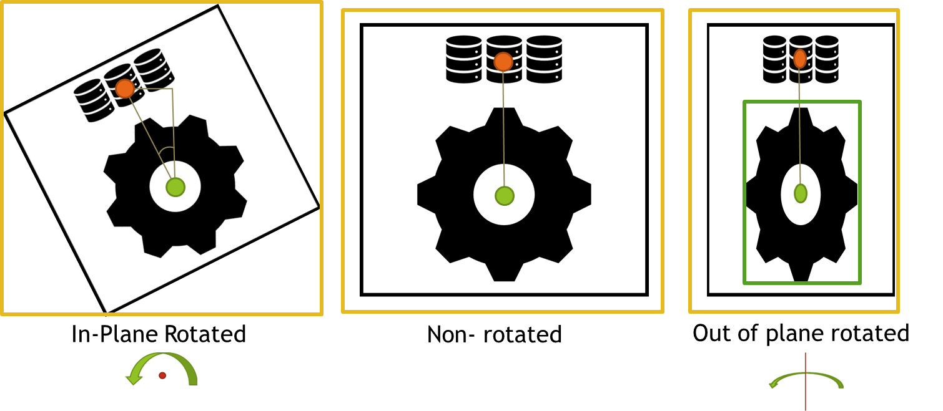
Methods continued
Once the objects have been detected and verified by the algorithm (i.e. they exist and have a high confidence) the following properties are calculated using the center points and bounding boxes of the classes detected. See below.
Center points are used with trigonometry to find the in plane rotated angle.
Gear width and height used to calculate out of plan rotation vertically and horizontally.
Object bounding box diagonal used for overall scaling

Slide 5
Darknet Yolo v3 tiny
To start, the git repo of the darknet yolo models must be downloaded, this also includes instruction on how to use it.
https://github.com/AlexeyAB/darknet
Once the repo is downloaded it must then be compiled using visual studio, preferably 2015.
The last step is to use the built in commands to test and train the model.

Slide 6
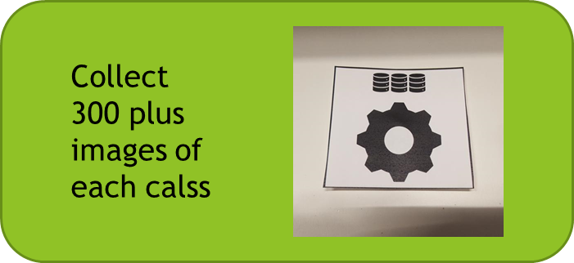
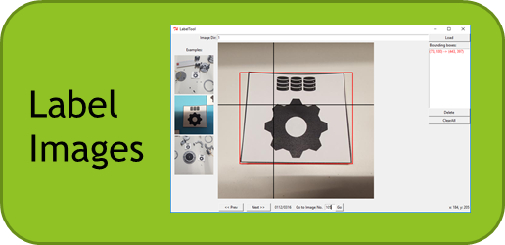
Training
When Darknet has been successfully compiled and verified to be working the training can begin.
Training for ODO was tedious and time consuming but serves as the initial training for the model. The quality of the bounding box labels determines how precise the predictions will be. The below diagram shows the training/labeling process which is repeated for each class (3 in this case).
Current training uses high confidence images as new training images both in a regular state as well as inverted to give the model new perspectives. This highly automates the training and labeling aspect.
X number of classes
Train on Images

Slide 7
Converting to Python
Unfortunately the Darknet YOLO model is compiled in C code which does not lend itself to be easily ported to python.
Fortunately the OpenCV library “cv2” has built in functions to read various types of neural network files (layers and weights). In this case it is used to construct the darknet YOLO v3 tiny model in python and then retrieve the outputs (classification and bounding boxes)
One down side to the OpenCv library is that it does not support GPU computing for the neural network which impacts the frame rates of the live demo.

Slide 8
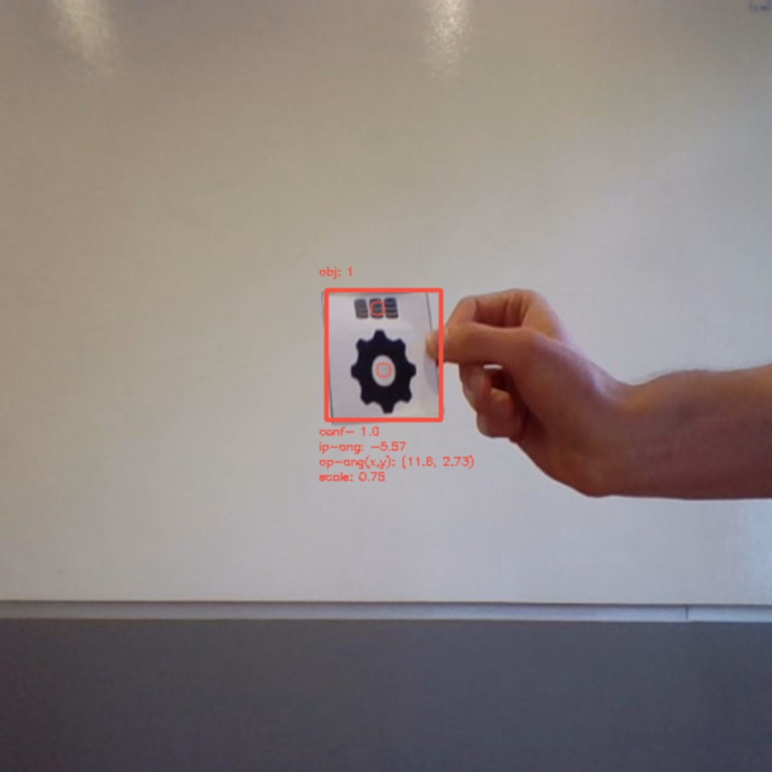
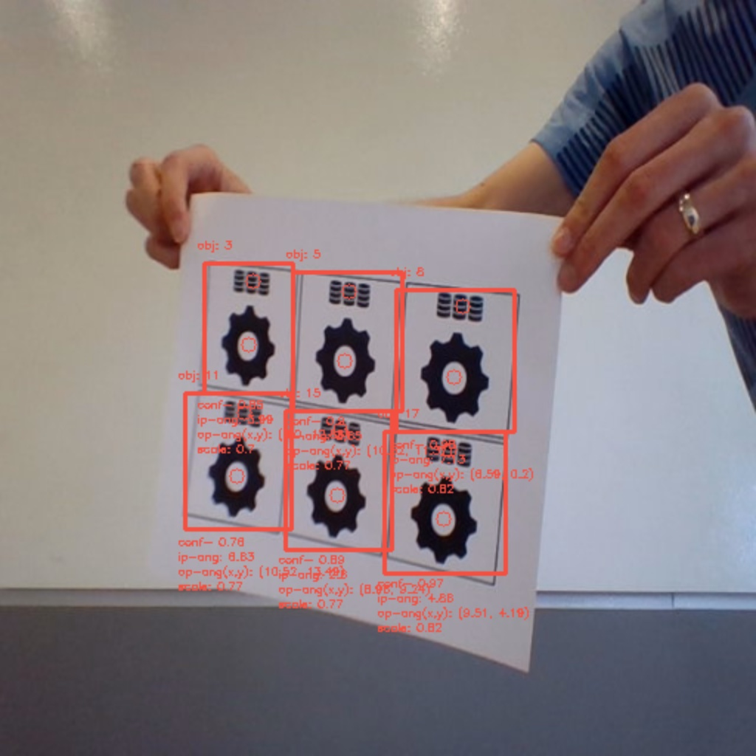
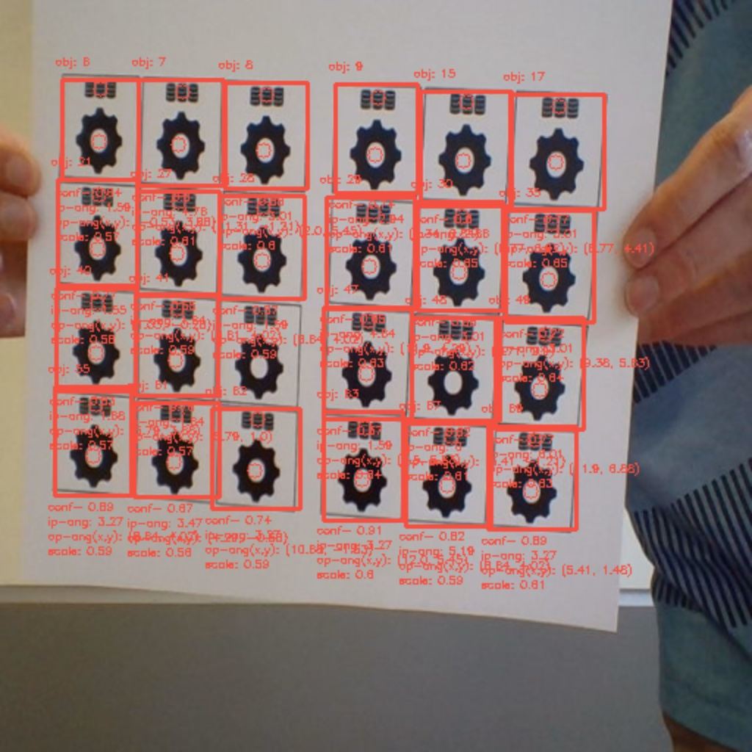
Results
The results of this project were better than expected. The model is able to track the object easily and consistently. Additionally the algorithm is able to calculate the scale and in plane rotation well. As for the out of plane rotation, the results can be improved (works about 50% of the time). The algorithm is also able to calculate many objects at once as seen in the example images below.
75% of nominal size (scale 1.0)
Out of plane rotation. Rotated 11.8 degrees back about the horizontal axis and 2.73 degrees to the side about the vertical axis.
In plane angle rotated 5.57 degrees counter clockwise

Slide 9
Future Goals
While the algorithm as a whole works as expected, several things are left to be desired that could be improved in the future
1. GPU computing for the converted python code, by switching to a GPU to compute the NN results, a doubled frame rate may be achievable. (doubled would be around 14 FPS)
2. The out of plane calculations do not always get calculated correctly. This is because these calculations are highly dependent on both the scaling calculations and the bounding boxes. In the future more detailed training and a more deterministic object to detect may help this.
3. Overall more powerful hardware would allow faster training and front end computing for demonstrations.

Slide 10
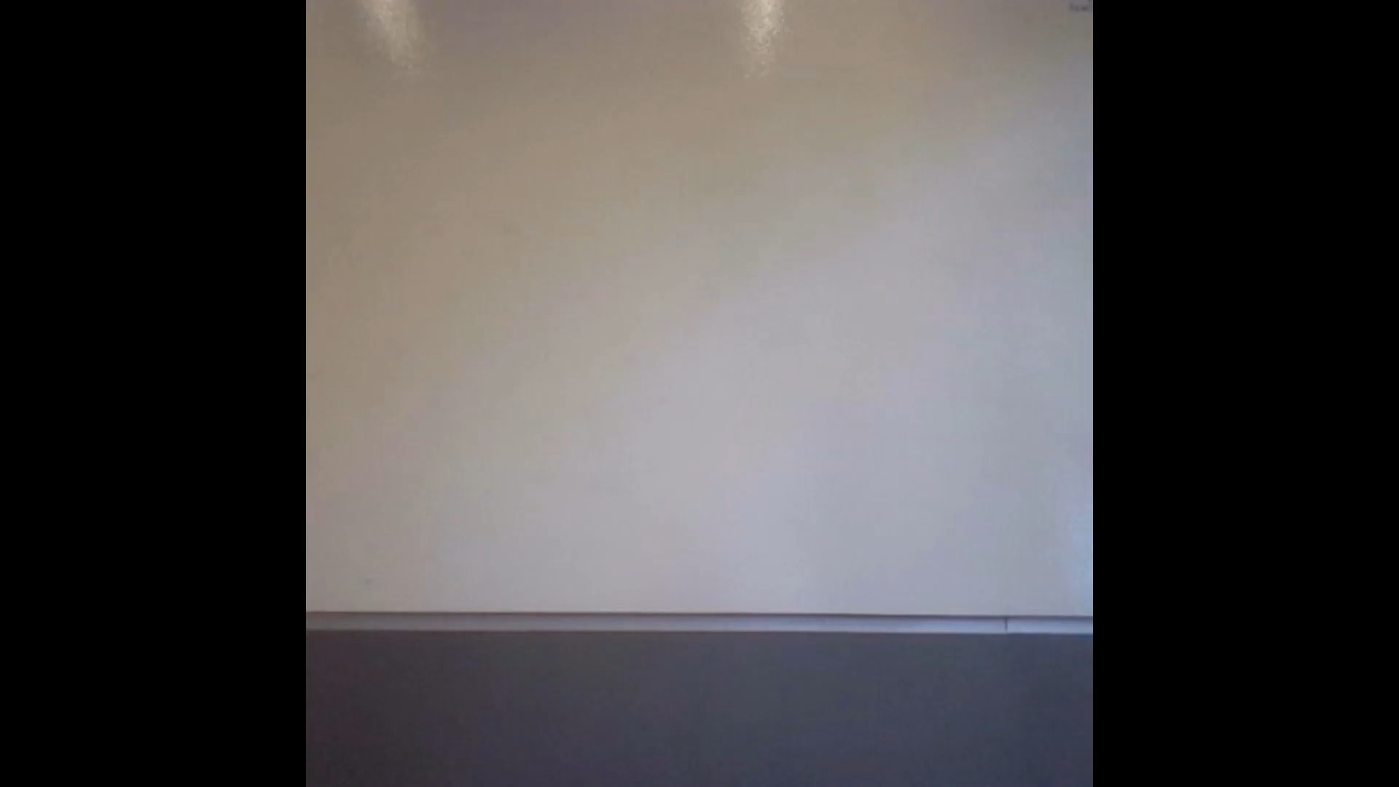
Demo

